Slide 1



Slide 2
Everyone is in a panic at the picnic because all the items keep going missing. Can you see which items go missing in each of these rounds?

Slide 3
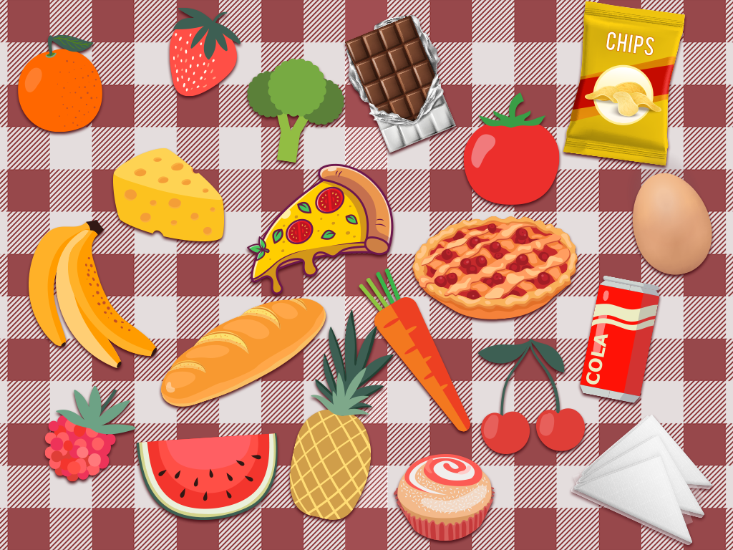

Slide 4
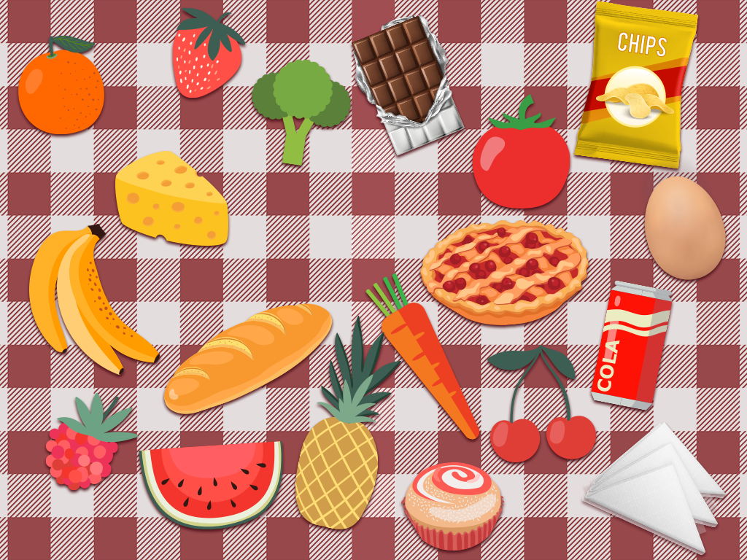

Slide 8
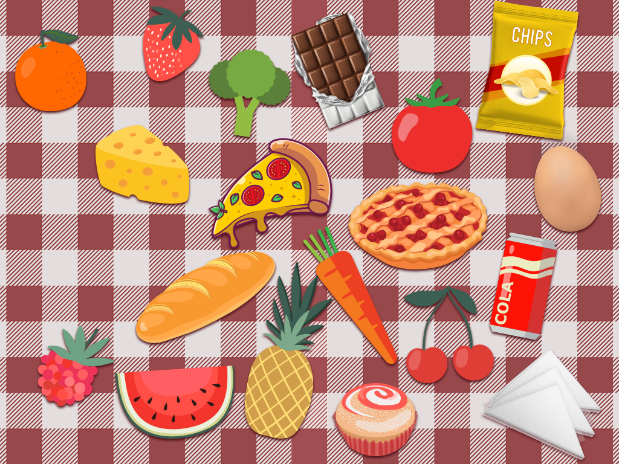

Slide 12
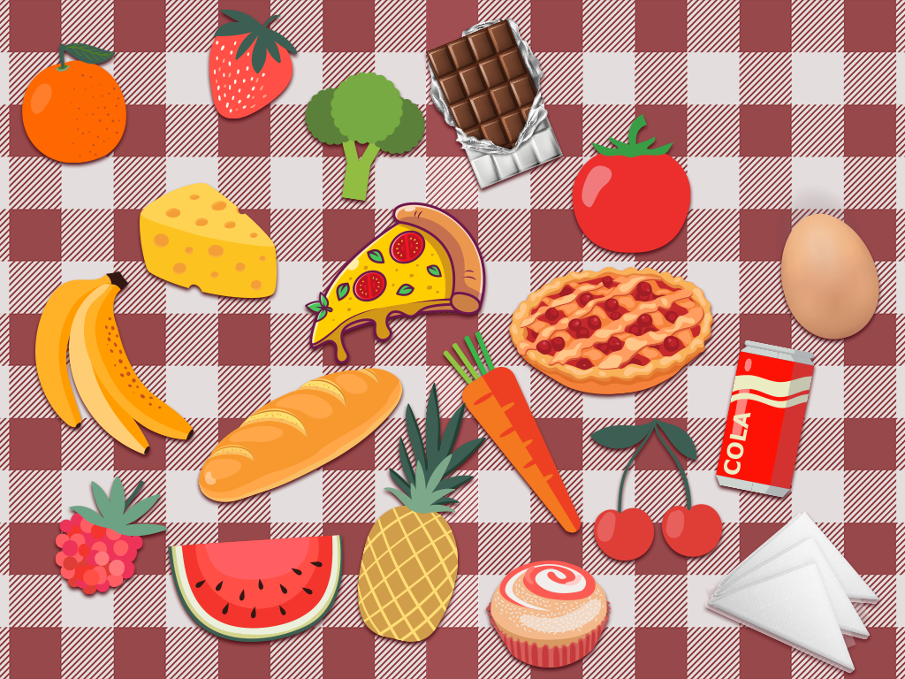

Slide 16
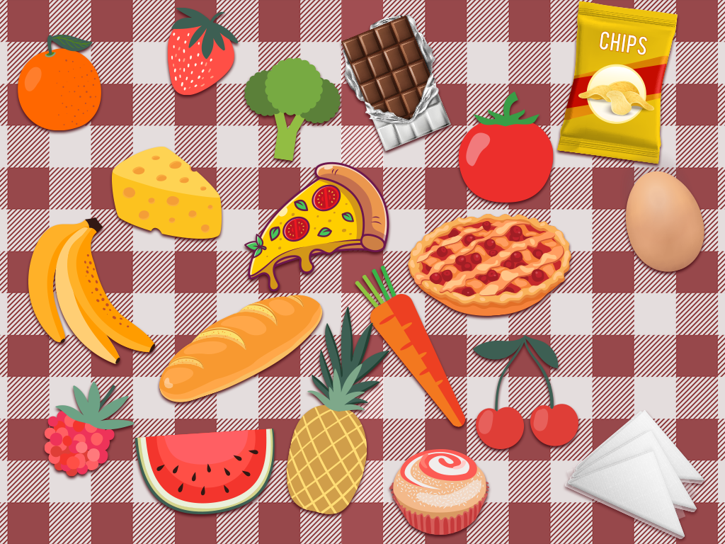

Slide 20
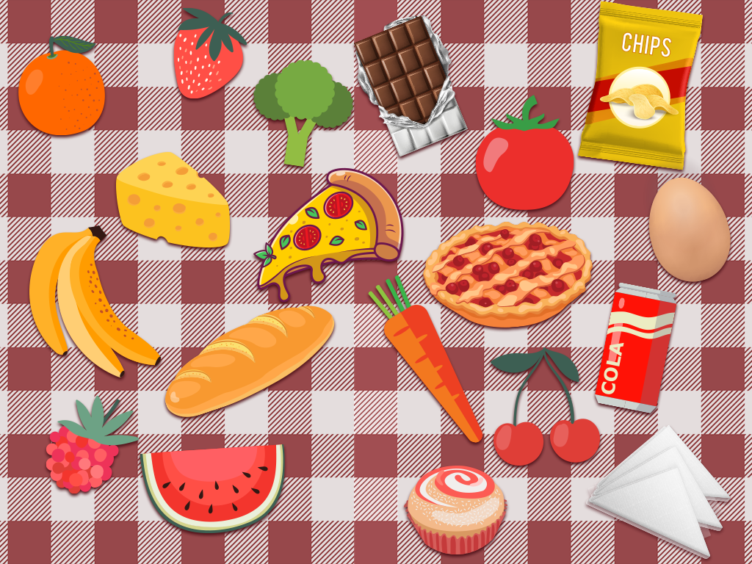

Slide 23
