Slide 1


Slide 2
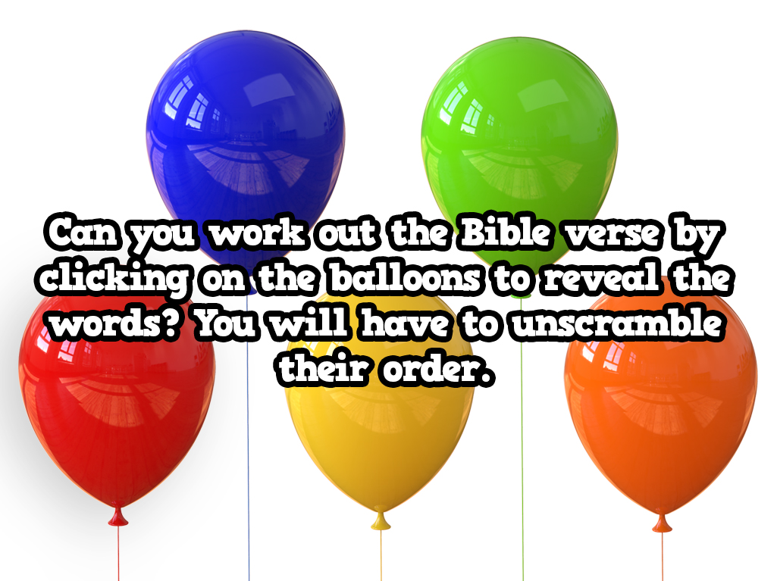

Slide 3

2
4
1
3
5
Read the full Bible verse here

Slide 4

The one believing in Me,
Click the here to link back to the balloons

Slide 5

he will live.
Click the here to link back to the balloons

Slide 6

I am the resurrection
Click the here to link back to the balloons

Slide 7

even if he should die,
Click the here to link back to the balloons

Slide 8

and the life.
Click the here to link back to the balloons

Slide 9
I am the resurrection and the life. The one believing in Me, even if he should die, he will live.

